Slide 1
Project Coordination

Slide 2
Before the First Sprint
Project Backlog has to be created
Minimum requirements for backlogs
ID
Name
Priority (Customer or a group with domain knowledge)
Estimation (NOT in a time format)
How to Demo (How to use the feature)
Note (Short description of the implementation method)
Done (Mark if the feature is complete)
Google Docs Template (link)
Italic is optional

Slide 3
General Rules
All backlogs must be available for all groups at any time (SVN or Google Docs)
Rules when adding features to another groups backlog
In case of multiple features, should the features be prioritized before handed over
All features should be well described

Slide 4
Sprints
Asynchronous vs Synchronous

Slide 5
Asynchronous vs Synchronous
Asynchronous
Synchronous
Pros
Finish features quick and make them available for other groups before the next sprint
No time spent on presenting plans and evaluations for the other groups
Cons
No experience sharing
No direct influence on the other groups sprint planning (besides adding features to the backlog)
No information about the other groups plans an evaluation
Pros
Planned experience sharing
Plans are presented for all groups and everyone can influence on the plans
Easier to be involved, by giving feedback on presentations
Cons
All groups have to use the same sprint length
Spent time on other groups presentations of their work
Features has to be completely done at the end of a sprint in case another groups has to use it in the next sprint

Slide 6
Discussion
Asynchronous vs Synchronous

Slide 7
Vote
Asynchronous vs Synchronous

Slide 8
sprints
Generalities – Planning, Sprints, Evaluation

Slide 9
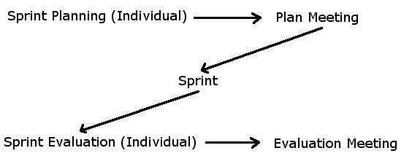
Work Form
Sprint Planning, Plan Meeting, Sprint Evaluation and Evaluation Meeting is max. 1 hour

Slide 10
Sprint Planning
Each group plan what features to complete in the next sprint
Features from other groups are added to the project backlog at this meeting

Slide 11
Plan Meeting
Presentation of the plan for the next sprint
Everyone can suggest changes to the plan, in case they need a feature to be done, to continue with their project.
This meeting ends with a completed sprint backlog

Slide 12
Sprint
Work with the tasks planned in the sprint backlog
Tasks in the sprint backlog are complete at the end of the sprint
Completed tasks are both bugfree and tested

Slide 13
Sprint Evaluation
Each group evaluates on their sprint
Questions could be
What have we done?
Did we miss anything?
What are we going to do in the next sprint?
What did we learn from this sprint?
What are we going to do differently in the next sprint?
Prepare a demonstration of the features implemented in the sprint
Prepare a presentation of the things discussed at the sprint evaluation

Slide 14
Evaluation Meeting
Present the things discussed at the evaluation meeting
What have we done?
Did we miss anything?
What are we going to do in the next sprint?
What did we learn from this sprint?
What are we going to do differently in the next sprint?
Length of the next sprint

Slide 15
Project Planning
Strict vs Self-controlled

Slide 16
Strict vs Self-controlled
Strict
Self-controlled
Divided
Keywords:
3 periods
Shared introduction
Development
Report
Altering
Keywords:
Altering between development and report
Report is planned between sprints
Individual sprint plans
Develop when it is appropriate for the group
Write report when it is appropriate for the group

Slide 17
Strict vs Self-controlled
Strict
Self-controlled
Pros
Everyone develops at the same time
The code is reviewed at least three times
Cons
Not everyone finishes programming simultaneously
Everyone cant start simultaneously
Everyone works with the area planned in the model
Pros
Groups always work form their backlogs and priorities
Groups decides what to do in the sprints
Groups can develop when they are ready to do it
Groups can stop developing when they don’t have any features to add
Cons
Groups don’t develop simultaniously
Groups may have to wait for another group to get into a development sprint

Slide 18
Discussion
Strict vs Self-controlled

Slide 19
Vote
Strict vs Self-controlled

